Slide 1
Docker Workshop
Andreas Mosti | Bendik Solheim | Trym Sneltvedt
Bekk Consulting

Slide 2
Intro

Slide 3
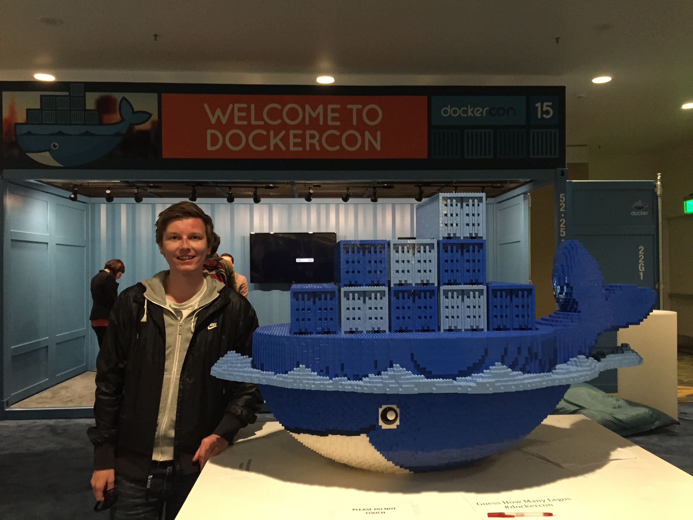

Slide 4
Why containers?

Slide 5



Slide 6


Slide 7







Slide 8



Slide 9
Shipping is hard!

Slide 10

Notes:
International Organization for Standardization (ISO) standard 668:2020 8 feet (2.44 m) wide, and of either 20 or 40 feet (6.10 or 12.19 m) standard length

Slide 11


Slide 12
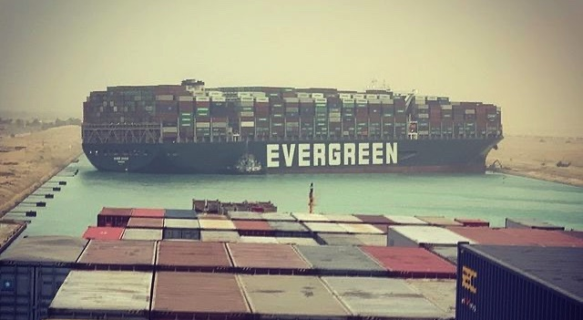

Slide 13


Slide 14

Notes:
solomon hykes

Slide 15
Specification for packaging,
shipping and running services

Slide 16
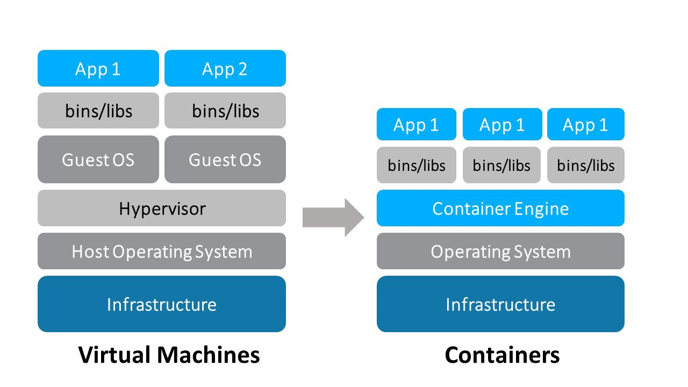

Slide 17
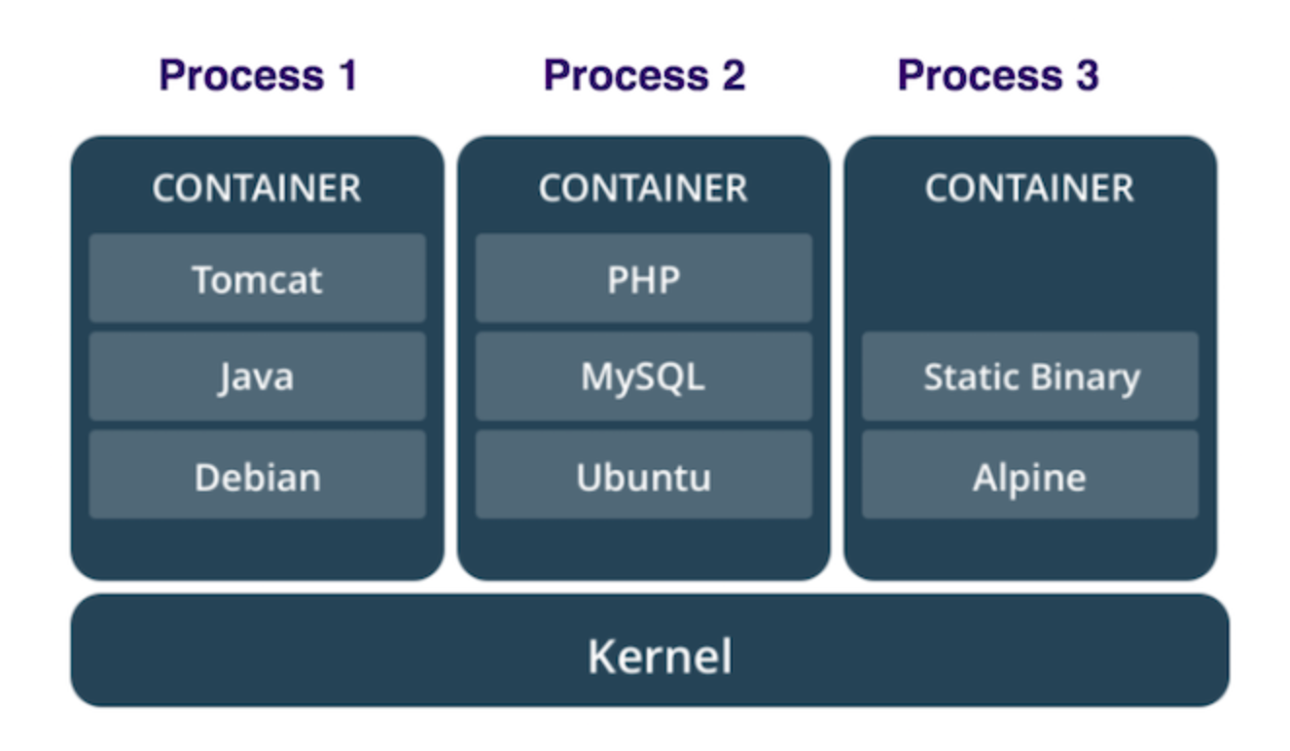

Slide 18
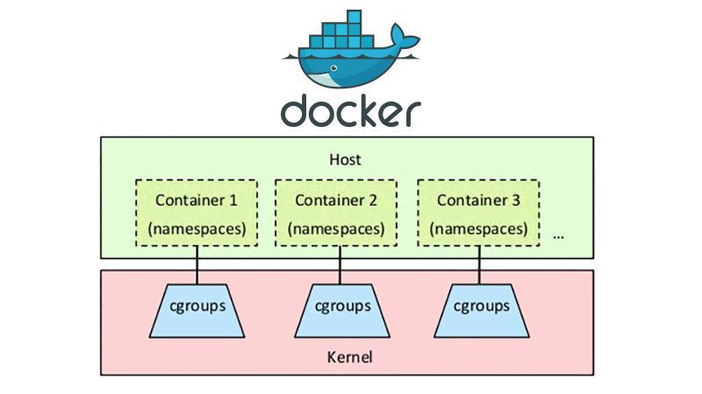
Notes:
cgroups (abbreviated from control groups) is a Linux kernel feature that limits, accounts for, and isolates the resource usage (CPU, memory, disk I/O, network, etc.) of a collection of processes. While not technically part of the cgroups work, a related feature of the Linux kernel is namespace isolation, where groups of processes are separated such that they cannot "see" resources in other groups.

Slide 20
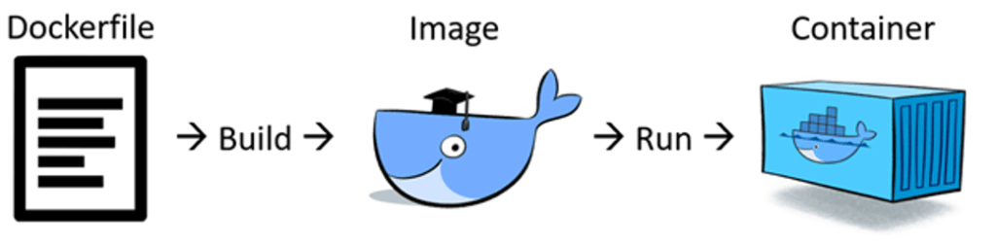

Slide 21
Containers are minimal

Slide 22
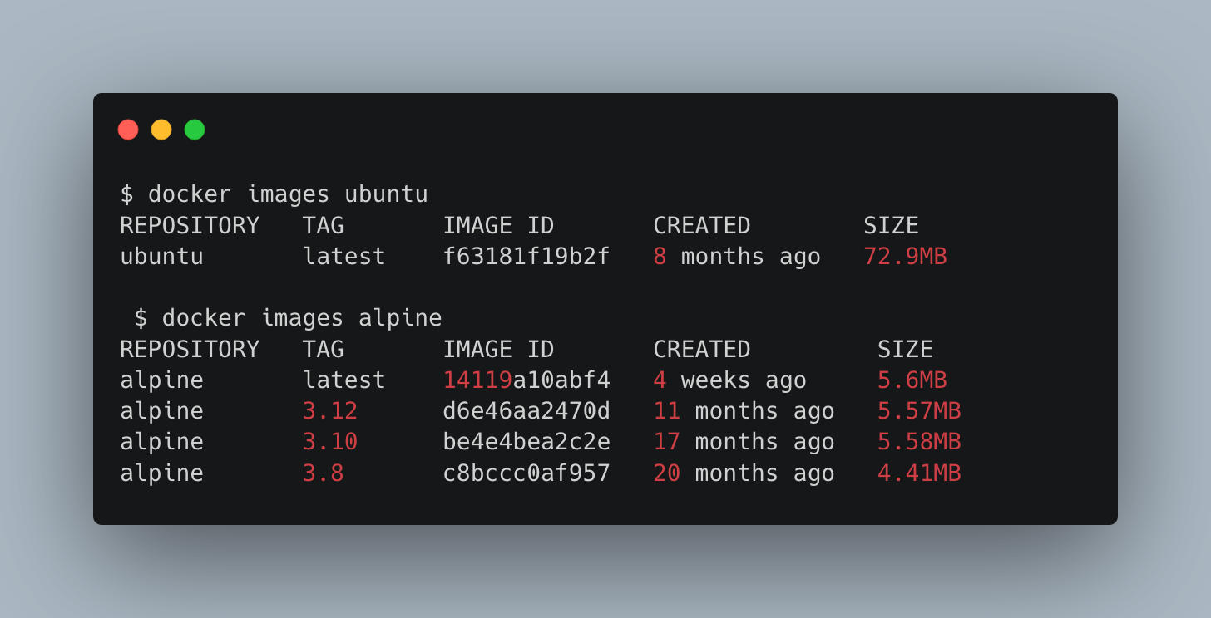

Slide 23
Containers are task-specific

Slide 24
Containers are isolated

Slide 25
Containers are reproducible (ish)

Slide 26


Slide 27
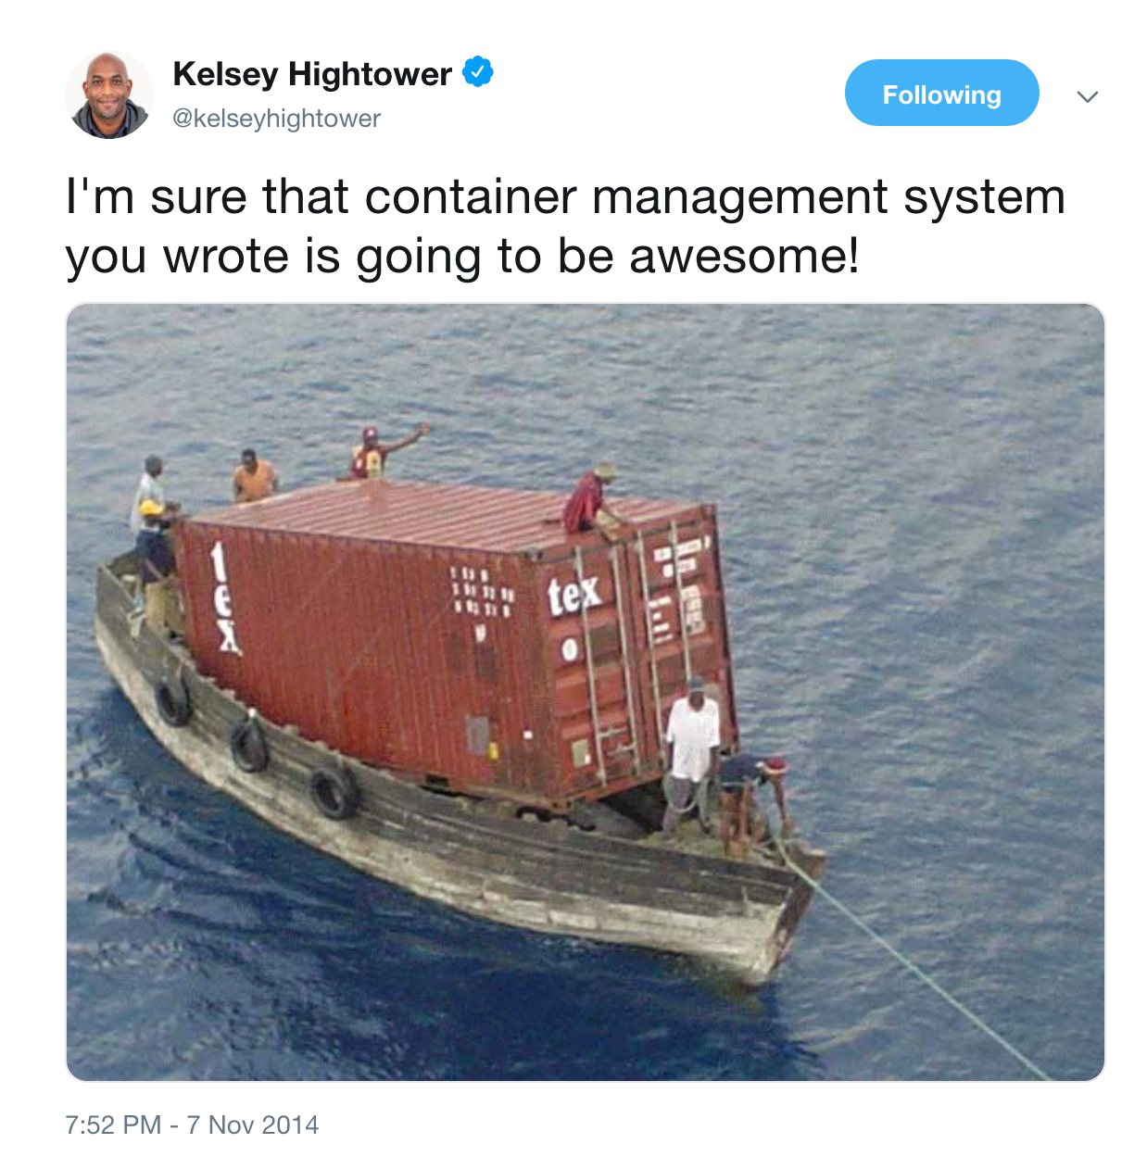

Slide 28
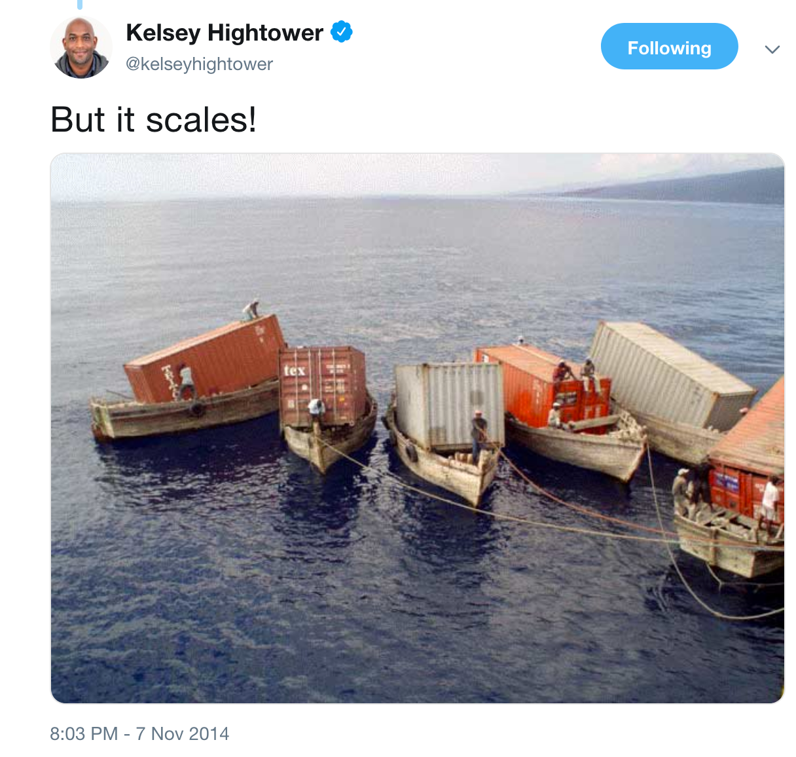

Slide 29
